Slide 1
FAIR FAST FARE
A Database Management System for Multi-Query of:
taxi Route Coordination and Shift Fare tally

Slide 2
Table of Contents
Executive Summary
E/R Diagram with Key allocation, subtypes, and relations between Entities
Functional Dependencies
Brief Description of Entities, Create statements and Insert Into statements
Create Statements for Entities including Insert Into Statements
Queries of Daily Impact
Stored Procedures
Implementation Notes
Known Problems
Future Enhancements

Slide 3
Executive Summary
The ‘Fair Fast Fare’ DBMS has been created with the idea that the entire system of employee management, routing calls, daily tasking and record, currency processing for Driver Average profit, Customer Average spend, Total shift Bookout, and Interpersonal Retrospective is able to be processed with great ease.
Gone are the days of paper dismay, ticket shuffle, and multiple calculations; let alone the aspect of Human Error.
The Record of People managed provides Subtypes of business occupation; whether it be Customer, Driver, or Dispatcher. Each are relational connect thru a simple yet divisive correlation to best suit the analysis of daily trips.
Includes Stored procedures that are built for Implementation with little input needed. These can also be ‘ReIntegrated’ or ‘Built from Concept’ if needed and plausibly creatable.
Implement notes, Known Problems, and Future Advancements also included!

Slide 4
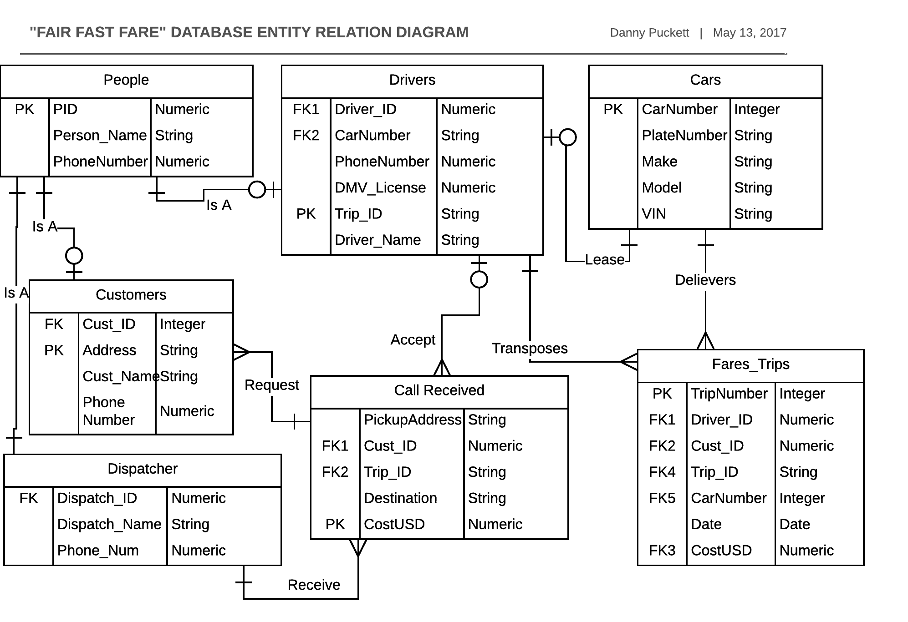
Entity Relation Diagram

Slide 5
Functional Dependencies
People Entity:
Name and Phone Number is functional dependent on PID
Customer Entity:
Cust_ID is functionally dependent on PID of People Entity
Cust_ID, Name, and PhoneNumber is functionally dependent on Address
Dispatcher Entity:
Dispatch_ID is functionally dependent on PID of People Entity
Dispatch_ID and PhoneNumber are functionally dependent on Dispatch_Name
Drivers Entity:
Driver_ID is functionally dependent on PID of People Entity
Driver_ID, CarNumber, PhoneNumber, DMV_License, and Driver_Name are functionally dependent on Trip_ID
CarNumberD is functionally dependent on CarNumber of Cars Entity

Slide 6
Functional Dependencies [Cont.]
Cars Entity:
PlateNumber, Make, Model, and VIN are functionally dependent on CarNumber
Calls_Received Entity:
PickupAddress and Destination are functionally dependent on Cust_IDR with Trip_IDR and CostUSD [for greatest durability]
Cust_IDR is functionally dependent on Cust_ID of Customer
Trip_IDR is functionally dependent on Trip_ID of Drivers
Fares_Trips Entity:
Driver_IDZ, Cust_IDZ, Trip_IDZ, CarNumber, Date, and CostUSDZ are functionally dependent on TripNumber
Driver_IDZ is functionally dependent on Driver_ID of Drivers
Cust_IDZ with CostUSDZ and Trip_IDZ are functionally dependent on Cust_IDR with CostUSDR and Trip_IDR of Call_Received
CarNumberZ is functionally dependent on CarNumber of Cars

Slide 7
Brief Description of Entities, Create statements and Insert Into statements
Entities are also known as Tables, they are constructed of Attributes and their Relations also known as Rows and Columns
Create Statements are blocks of SQL code that are implemented to create the above mentioned Entities
Insert Into Statements are used to populated the Relations and Attributes of a given Entity with the normalization being the foundation of the DBMS system and its process effectiveness.
Normalization:
As follows: First Normal Form, Second Normal Form, Third Normal Form and the highly sought Boyce Codd Normal Form.

Slide 8
Create Statements, Insert Into Statements
-- Drop statements, for a fresh start of the DBMS
drop table People cascade;
drop table Drivers cascade;
drop table Customer cascade;
drop table Dispatch cascade;
drop table Cars cascade;
drop table Call_Received cascade;
drop table Fares_Trips cascade;

Slide 9
Entity: People
CREATE TABLE People(
PID Numeric (3) not null,
Person_Name Text not null,
PhoneNumber Numeric not null,
PRIMARY KEY ( PID )
);

Slide 10
Entity: Customer
CREATE TABLE Customer(
Cust_ID Numeric (3) not null,
Address Text,
Cust_Name Text not null references People (Person_Name),
PhoneNumber Numeric not null references People (PhoneNumber),
PRIMARY KEY ( Address ),
FOREIGN KEY ( Cust_ID ) references People (PID)
);

Slide 11
Entity: Dispatcher
CREATE TABLE Dispatcher(
Dispatch_ID Numeric (3),
Dispatch_Name Text not null references People (Person_Name),
PhoneNumber Numeric not null references People (PhoneNumber),
PRIMARY KEY ( Dispatch_Name ),
FOREIGN KEY ( Dispatch_ID ) references People (PID)
);

Slide 12
Entity: Call_Received
CREATE TABLE Call_Received(
PickupAddress Text,
Cust_IDR Numeric,
Destination Text,
CostUSD Numeric,
Trip_IDR Text,
PRIMARY KEY ( CostUSD ),
FOREIGN KEY ( Cust_IDR ) references Customer(Cust_ID),
FOREIGN KEY ( Trip_IDR ) references Drivers(Trip_ID)
);

Slide 13
Entity: Drivers
CREATE TABLE Drivers(
Driver_ID Numeric,
CarNumberD Integer not null references Cars (CarNumber),
PhoneNumber Numeric not null references People (PhoneNumber),
DMV_License Numeric,
Trip_ID Text,
Driver_Name Text not null references People (Person_Name),
PRIMARY KEY ( Trip_ID ),
FOREIGN KEY ( Driver_ID ) references People (PID)
);

Slide 14
Entity: Cars
CREATE TABLE Cars(
CarNumber Integer,
PlateNumber Text,
Make Text,
Model Text,
VIN Text,
PRIMARY KEY ( CarNumber )
);

Slide 15
Entity: Fares_Trips
CREATE TABLE Fares_Trips(
TripNumber Integer,
Driver_IDZ Numeric not null references Drivers(Driver_ID),
Cust_IDZ Numeric not null references Customer(Cust_ID),
Trip_IDZ Text not null references Call_Received(Trip_ID),
CarNumberZ Integer not null references Cars(CarNumber),
Trip_Date Date,
CostUSDZ Numeric not null references Call_Received(CostUSD),
PRIMARY KEY ( TripNumber )
);

Slide 16
Insert Into Statements
INSERT INTO People ( PID, Person_Name, PhoneNumber)
Values (001, 'Shaun_Miles', 8452140203),
(002, 'Joesph_Mehm', 8455148982),
(003, 'Max_Durocher', 5553218294),
(004, 'Vincent', 5552655283),
(005, 'Louie_De_Palma', 5558294222),
(006, 'John_Carpenter', 9142407438),
(007, 'Alan_Labouseur', 8455753000),
(008, 'Sun_Jones', 8452789362),
(009, 'Shannon_Lee', 8454791826),
(010, 'Anne_Frier', 8452140203),
(011, 'Danny_Puckett', 8452406391),
(012, 'Darielle_Clarke_Harris', 8454641928);

Slide 17
Insert to Customer
INSERT INTO Customer( Cust_ID, Address, Cust_Name, PhoneNumber)
Values (004, 'Vincent', 5552655283),
(006, 'John_Carpenter', 9142407438),
(007, 'Alan_Labouseur', 8455753000),
(012, 'Darielle_Clarke_Harris', 8454641928);

Slide 18
Insert to Dispatcher and Drivers
INSERT INTO Dispatcher( Dispatch_ID, Dispatch_Name, PhoneNumber)
Values (001, 'Shaun_Miles', 8452140203),
(010, 'Anne_Frier', 8452140203);
INSERT INTO Drivers( Driver_ID, CarNumberD, PhoneNumber, DMV_License, Trip_ID, Driver_Name)
Values (002, 2, 8455148982, 678555099, 'E-XF', 'Joesph_Mehm'),
(003, 1, 5553218294, 656566565, 'F-XF', 'Max_Durocher'),
(005, 3, 5558294222, 253455849, 'E-F', 'Louie_De_Palma'),
(008, 4, 8452789362, 849776545, 'E-XF', 'Sun_Jones'),
(009, 1, 8452791826, 578673341, 'E-F', 'Shannon_Lee'),
(011, 4, 8452406391, 622456764, 'E-XF', 'Danny_Puckett');

Slide 19
Insert to Call_Received and Cars
INSERT INTO Call_Received(Pickup_Address, Cust_IDR, Trip_IDR, Destination, CostUSD)
Values ('Hollywood_Blvd', 004, 'XF29', 'TBD', 99),
('Pleasent_Valley', 006, 'F08', 'TBD', 14),
('Marist_College', 007, 'E02', 'TBD', 9),
('Main_St', 012, 'F09', 'TBD', 11);
INSERT INTO Cars(CarNumber, PlateNumber, Make, Model, VIN)
Values (1, 'ABC123TX', 'Chevy', 'Impala', '45671476453928'),
(2, 'XVF27LV', 'Chevy', 'Malibu', '57291476492852'),
(3, 'X6435LV', 'Chevy', 'Impala', '93874621145820'),
(4, 'A45B7TX', 'Chevy', 'Impala', '39478653728482');

Slide 20
Insert to Fares_Trips
INSERT INTO Fares_Trips(TripNumber, Driver_IDZ, Cust_IDZ, Trip_IDZ, CarNumber, Trip_Date, CostUSDZ)
Values (15, 003, 004, 'XF29', 1, 2016-11-18, 99),
(4, 002, 006, 'F08', 2, 2016-11-18, 14),
(3, 009, 007, 'E02', 3, 2016-11-18, 9),
(7, 011, 012, 'F09', 4, 2016-11-18, 11);

Slide 21
Queries of Daily Impact
Name search with a completed bookout based on date and name
Select TripNumber, Driver_IDZ, Cust_IDZ, Trip_Date, CostUSDZ
From Fares_Trips
Where (Trip_Date = '2016-11-18' && (
Select Driver_Name
From Drivers
Where Driver_Name = 'Danny_Puckett'));

Slide 22
Stored Procedures – Double Checker
Tally/Booking Function <?php ($TripNumber > 0 ) $Total=$Total+$CostUSD : $Total; ?>
Select ($Total=$Total + $Price)
From Fares_Trips;

Slide 23
Implementation Notes
A creation of Record [Database] for a taxi company would built of of the first set of inputted data; whether by document offset inclusion to a php form then transferred into sql Insert Into statements.
As for the DBMS applied here there is a skeleton, in comparison to what you would be containing within your database. Thinking about backing up your database, the size of your entire DBMS and Content, and hiring a database manager for processing incoming data.

Slide 24
Known Problems and Future Enhancements
The sql code was a bit misdetermined, yet the DBMS and its intuitiveness had endured.
As for future enhancements:
A push button input pad to control the inputs based on search of the database and well developed stored procedure functions
Possibly a new

Slide 26
FAIR FAST FARE
Created May 2017
A Danny Puckett Dbms Project
All concepts, theories derived, Processes, Code, or implied physical implementation are the sole intellectual property of Danny Puckett

